Slide 1

Fake News Detection
NAME-ShIVANSH SAPRA
Batch-7644

Slide 2
PROBLEM STATEMENT
The rise of social media and online platforms has made it easier for fake news to spread rapidly across the internet, reaching millions of people within a short period. This has serious implications for individuals, organizations, and even governments, as fake news can be used to create panic, incite violence, or influence public opinion.
This Machine Learning model is used to detect whether a news is fake or not using Python.

Slide 3
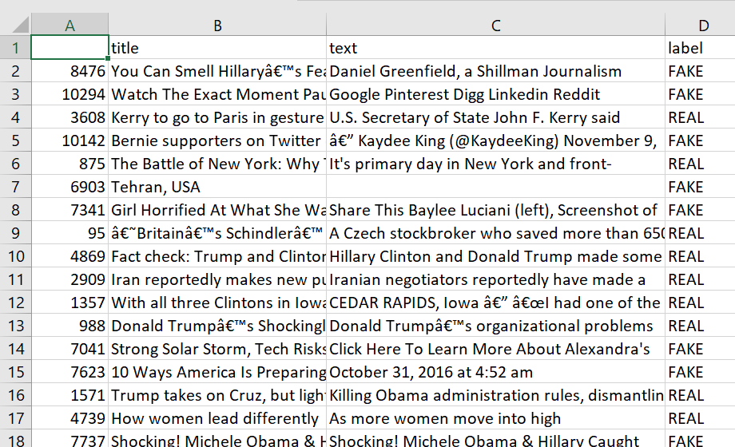
The Dataset
The dataset has 6335 rows and 4 columns. The first column identifies the news, the second and third are the title and text, and the fourth column has labels denoting whether the news is REAL or FAKE.

Slide 4
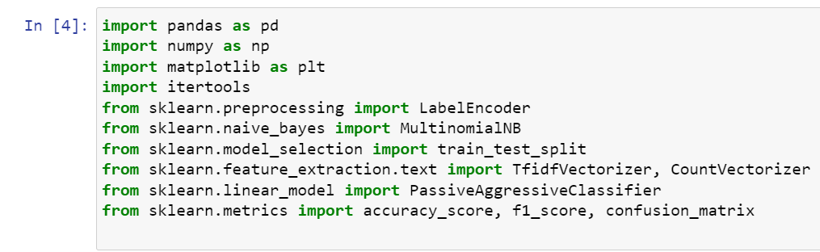
1. Importing the libraries

Slide 5
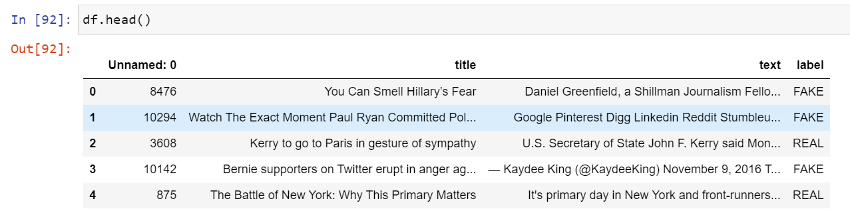
2. Loading the data into a dataframe using pandas.
3. Using the head function to view first 5 rows of the dataframe.

Slide 6
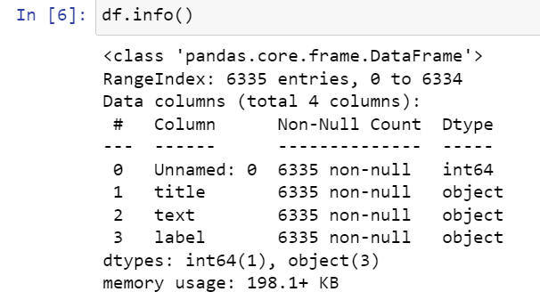
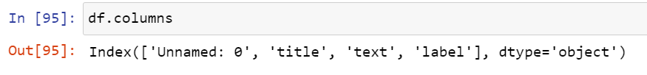
DATA EXPLORATION
4. Using the info function to get a basic information about our dataset.
5. Printing the names of the columns

Slide 7
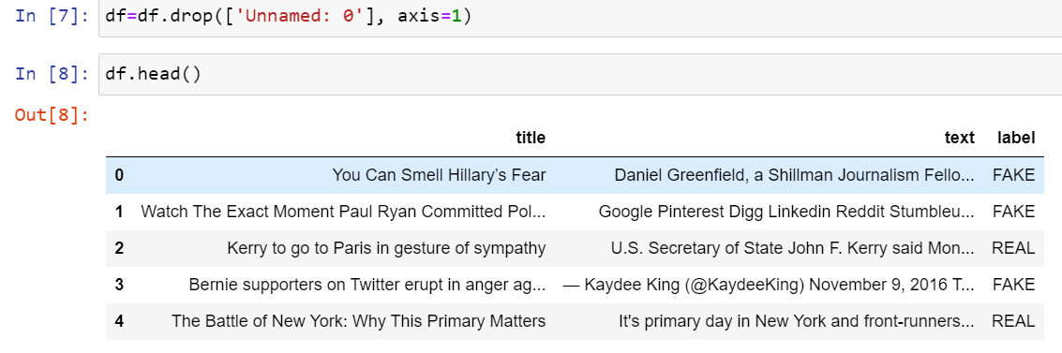
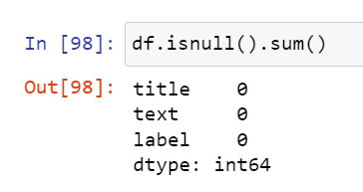
DATA CLEANING
6. Dropping irrelevant columns
7. Checking for null values

Slide 8
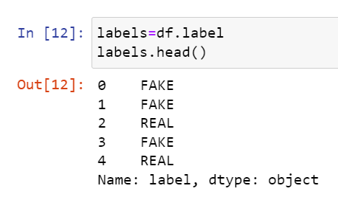
USING PASSIVEAGGRESIVE CLASSIFIER
8. Getting the labels from dataframe
9. Splitting the dataset into training and testing sets

Slide 9

10. Initializing a TfidfVectorizer
11. Fitting and transforming train set and transforming test set.

Slide 10

12. Initializing a PassiveAggressive Classifier and fitting it on tdif_train and y_train.
13. Predicting on test set from the TfidfVectorizer.

Slide 11
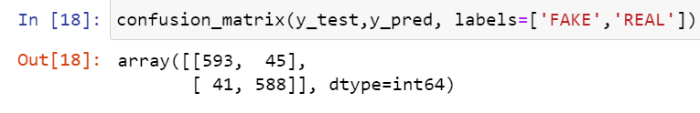
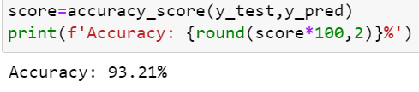
Performance Evaluation:
14. Printing the Confusion Matrix to gain insight into the number of false and true negatives and positives
15. Finding the Accuracy Score

Slide 12

USING NAÏVE BAYES ALGORITHM
17. Splitting the data in X and Y columns
18. Splitting the dataset into training and testing sets

Slide 13
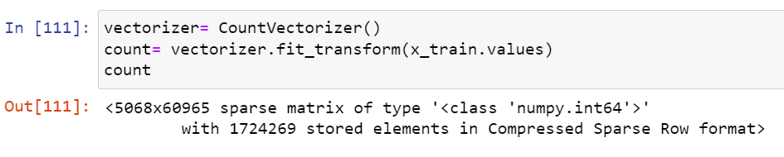
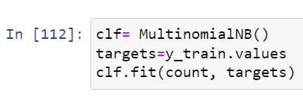
19. Vectorizing the dataset using CountVectorizer
20. Fitting the classifier and making prediction.

Slide 14
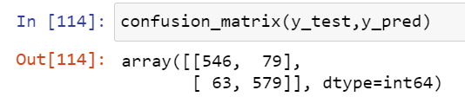
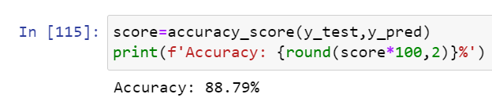
Performance Evaluation:
21. Printing the Confusion Matrix
22. Finding the Accuracy Score

Slide 15
SUMMARY:
It was observed that PassiveAggresive Classifier provided a better accuracy score than Naïve Bayes Classifier by 4.42%.
THANK YOU

